Slide 1


Call Center Performance Dashboard Insights
Purpose of the project: Analyzing Key Metrics and Trends Presented by: Devanshi Jignesh Bhatt

Slide 2
Project description
The given project is one of the tasks in Forage PWC Job Simulation which asks us to analyse Call-Centre data and draw some insights from it.
PowerBI is used to perform the visualization, allowing us to develop new measures using DAX Expressions and has varied charts.
In this project we are required to clean the data, find the total calls by all the agents, Average satisfaction score, Average response time, Number of topics, the most calls by the topic, Sum of resolved by topic, and speed of response and visualize them in charts.

Slide 3
overview
Introduction to the dashboard
Key metrics tracked:
Average Response Time
Average Satisfaction Score
Call Answered/Not Answered Ratio
Overview of the agents' performance and topics addressed

Slide 4
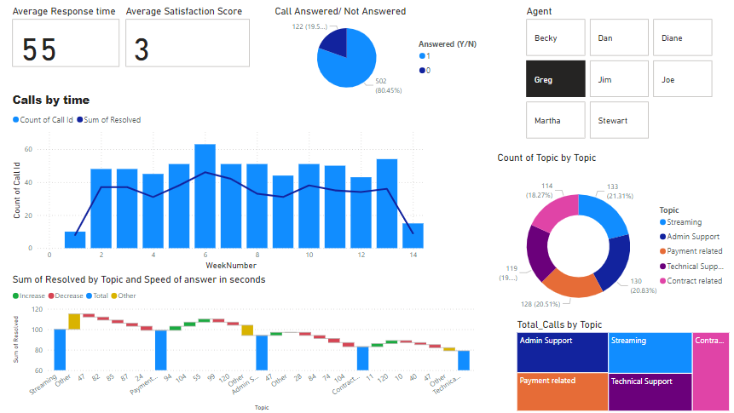
Dashboard

Slide 5
INSIGHTS

Slide 6
1.Data Loading and Transforming
The dataset was in an Excel file format and loaded in PowerBI.
The date column was transformed and divided into three columns date, time, and month name.
Month name was derived from date column by changing it’s format type.

Slide 7
2.Key metrics
Average Response Time:
The average response time for calls is 55 seconds.
This metric indicates the efficiency and responsiveness of the call center.
This is derived through the DAX Formula which calculates average.
Goal: Maintain or reduce the response time to improve customer satisfaction.

Slide 8
Average Satisfaction Score
The average satisfaction score is 3 on a scale of 1 to 5.
This score reflects customer satisfaction with the support provided.
Actionable Insight: Implement strategies to improve customer satisfaction, such as additional training for agents and enhancing problem-solving capabilities.
This is derived through the DAX Formula which calculates the average.

Slide 9
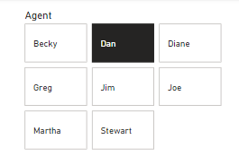
Agents list
This is a list made from Advanced Slicer which represents the unique names of Agents who work in the centre.
By selecting the button as per the names the graph changes its values accordingly.
All the example images are from the Agent named Dan.

Slide 10
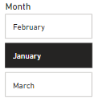
Month list
This is a list made from Advanced Slicer which represents the months in which the data was collected from the centre.
By selecting the button as per the names the graph changes its values accordingly.
All the example images are from January month.

Slide 11
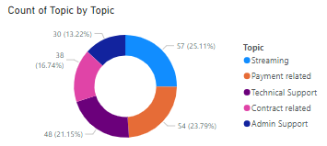
Topics for Calls
This doughnut chart shows the distribution of calls by topic.
Streaming (25.11%)
Admin Support (13.22%)
Technical Support (21.15%)
Payment Related (23.79%)
Contract Related (16.74%)
Insight: The majority of calls are related to Streaming and Contract issues.
Action Plan: Focus on addressing common issues in these areas to improve efficiency.

Slide 12
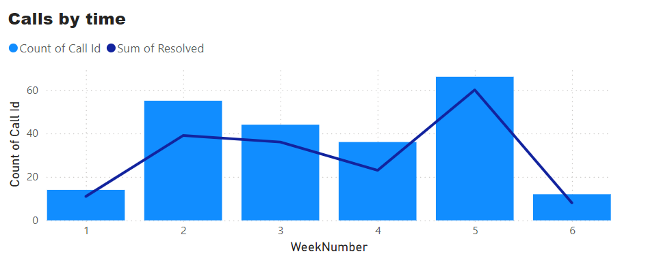
Calls by Time
Analysis of call volume and resolution over time.
This chart is of an Agent named Dan.
Peak call volume was observed during Week 5 and it also has the highest number of calls resolved.
Resolution times trend analysis: Identify periods of high efficiency and potential bottlenecks.

Slide 13
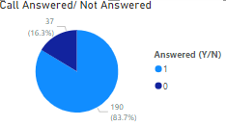
Call Answered/Not Answered Ratio
This data is from January month and of the Agent named Dan
Total calls answered: 190
Calls not answered: 37
This ratio is crucial for assessing the call center's availability and reliability.
Focus on reducing the number of missed calls by optimizing agent availability.

Slide 14
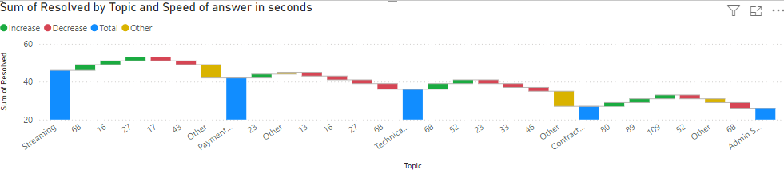
Resolution Time by Topic
Breakdown of average resolution time by topic.
Areas with longest resolution times: Contract and Admin Support.
Strategy: Develop targeted training and resources to reduce resolution times in these areas.

Slide 15
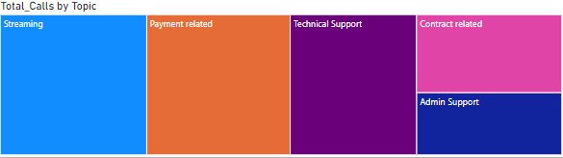
Top Topics for call purpose
Breakdown of the topics for which the callers call.
The largest area for which the callers call is Streaming purpose while the smallest reason for callers is Admin Support.

Slide 16
Conclusion and Recommendations
Summary of key insights:
Maintain/improve response times.
Enhance customer satisfaction scores.
Optimize agent availability and performance.
Focus on high-volume topics like Streaming and Contract issues.
Recommendations for next steps:
Implement regular training programs.
Monitor and adjust staffing levels based on call volume trends.
Develop specialized resources for common issue areas.

Slide 17
Thank you!

